Slide 1
Climate Change, Health, and Equity
February 24, 2015
Linda Rudolph, MD, MPH
Center for Climate Change and Health
linda.rudolph@phi.org
Notes:
----- Meeting Notes (11/11/14 11:03) -----

Slide 2
“Climate change is the biggest global health threat of the 21st century.” The Lancet “ Climate change threatens our fragile existence on this planet.” Jim Kim, World Bank
“Climate change is the defining health challenge of our time.”
Margaret Chan, World Health Organization
“Climate change is affecting agriculture, water resources, human health, and ecosystems on land and in the oceans. It poses sweeping risks for economic stability and the security of nations. We can avert these risks if we take bold, decisive action now.”
Ban Ki-Moon, U.N.

Slide 3
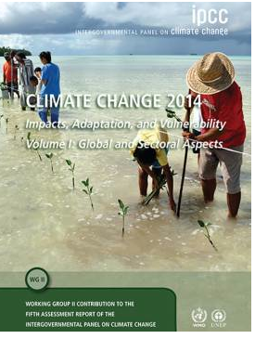
3rd National Assessment on Climate Change, 2014
http://nca2014.globalchange.gov/report/sectors/human-health
http://ipcc-wg2.gov/AR5/images/uploads/WGIIAR5-Chap11_FGDall.pdf

Slide 4
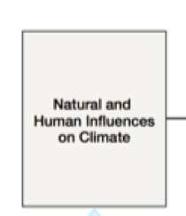
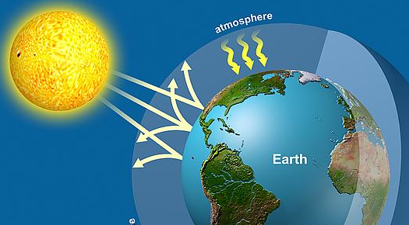
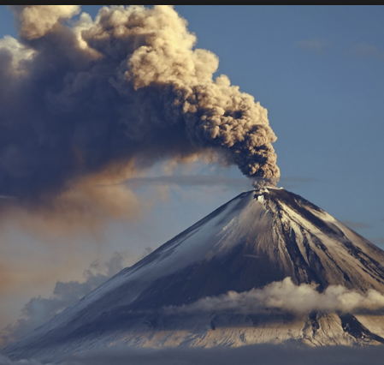
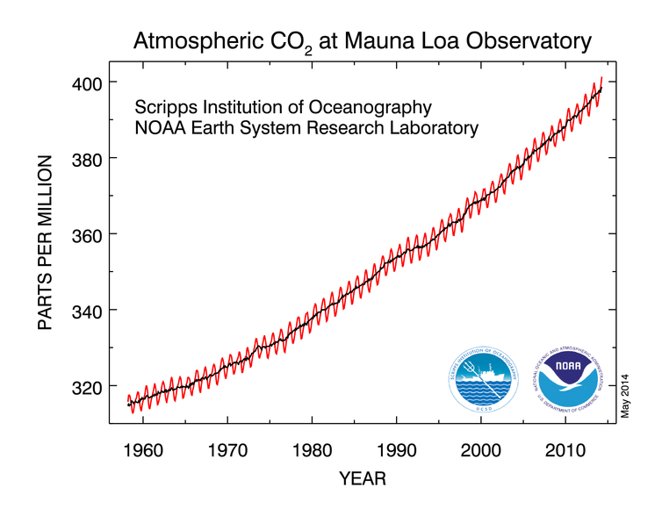
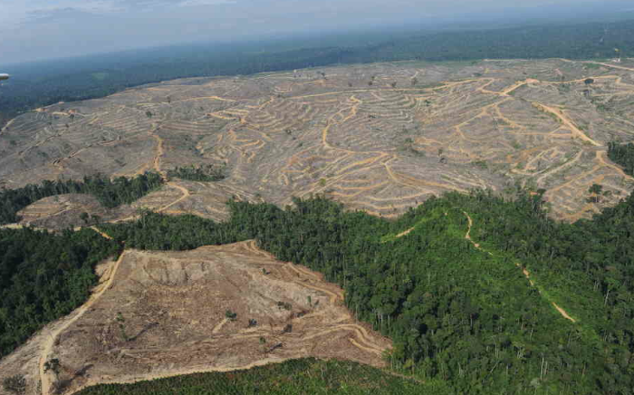
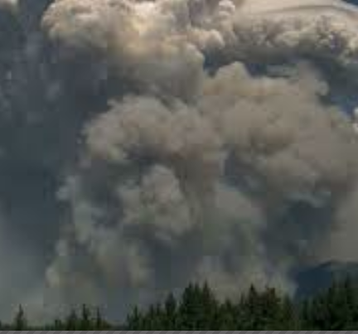
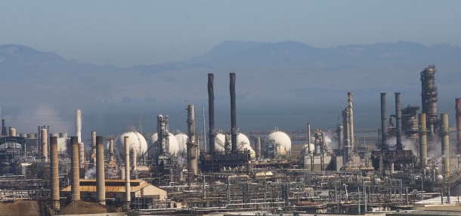
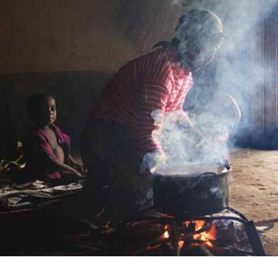
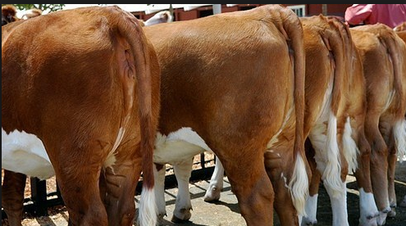
Greenhouse Gas
Emissions
Highest levels in 800,000
to 15,000,000 years
Notes:
To put in context – homo sapiens began to evolve around 200,000 years ago; oceans around 100 feet higher and world’s temperature around 11 deg F higher

Slide 5
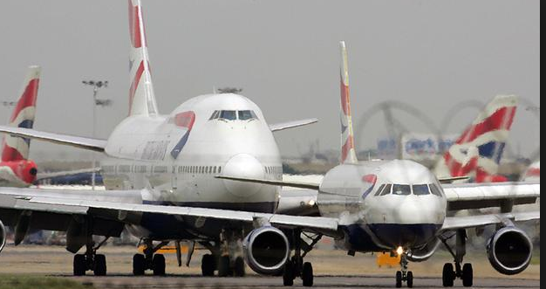
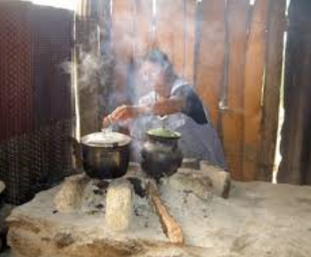
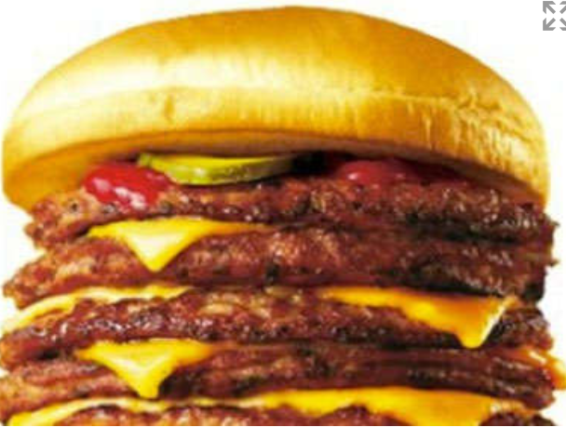
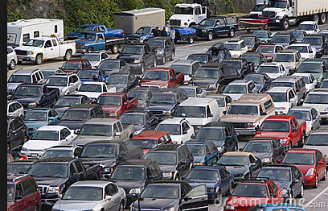
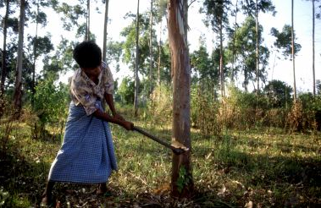
Climate
Behaviors
Anthropogenic:
caused or influenced by human activity
Notes:
"It is extremely likely [95 percent confidence] more than half of the observed increase in global average surface temperature from 1951 to 2010 was caused by the anthropogenic increase in greenhouse gas concentrations and other anthropogenic forcings together. ”IPCC 2014

Slide 6
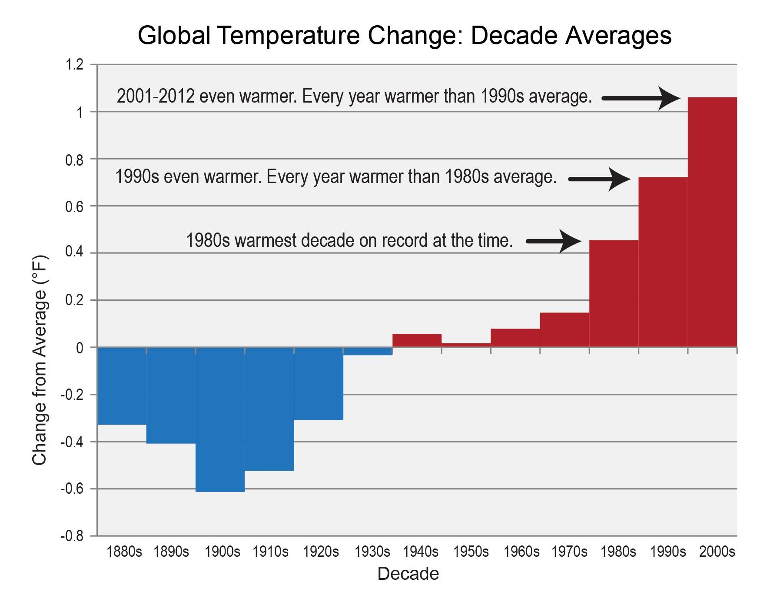
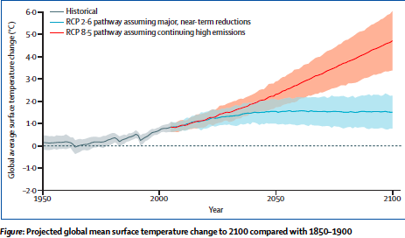
Global Climate Impacts:
Warming
USGCRP
IPCC AR5 2014
Notes:
With BAU: 4degC at end century, 8degC in 2300, 12degC longer term
Estimate 40% reduction in global labor capacity in hottest months in 2100.
Sir Andy Haines and co-authors – in Lancet last month – suggest that temerature extremes of this magnitude may cross the “afterlife threshold” – creating impacts so great that there is a discontinuity in the long-term progression of humanity.

Slide 7
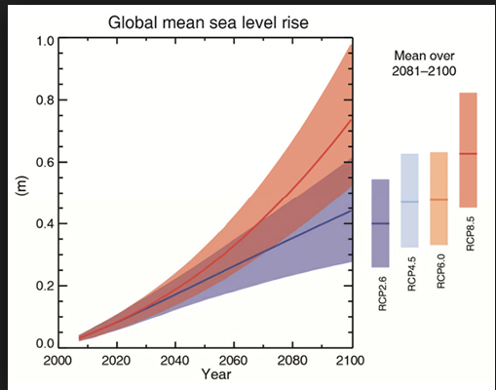
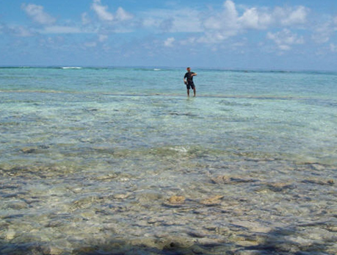
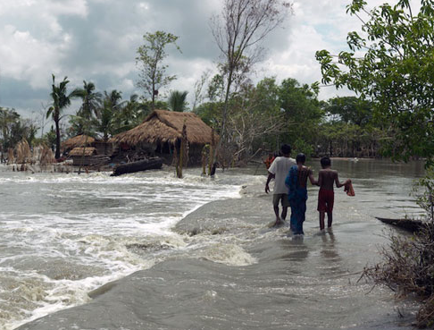
Global Climate Impacts:
Sea Level Rise
Micronesia
Sundarbands, India
Florida
Notes:
“Even the dead are no longer safe in my country," Micronesia's Ambassador to the UN

Slide 8
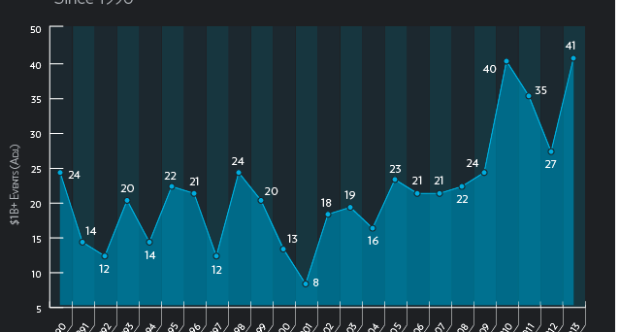
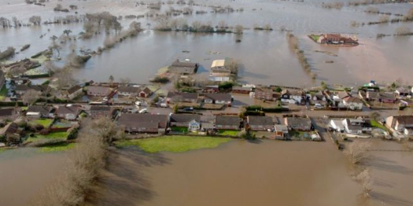
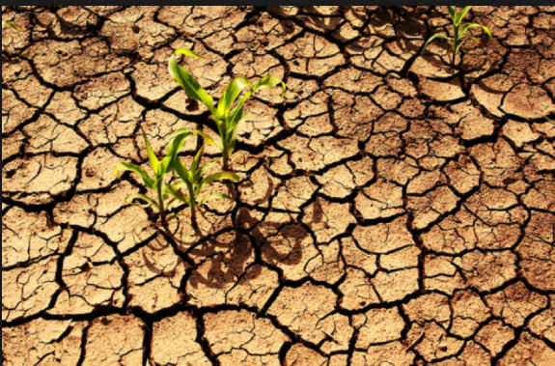
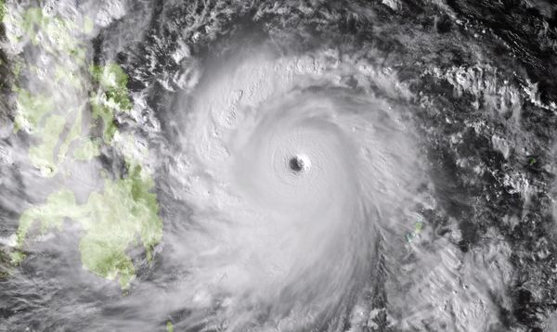
Global Climate Impacts:
Hydrologic Variability
Global Billion-Dollar Weather-Related Disasters since 1990
UK flooding 2013
Tuckerton N.J. after Sandy
Typhoon Haiyan, Phillipines, 2013

Slide 9
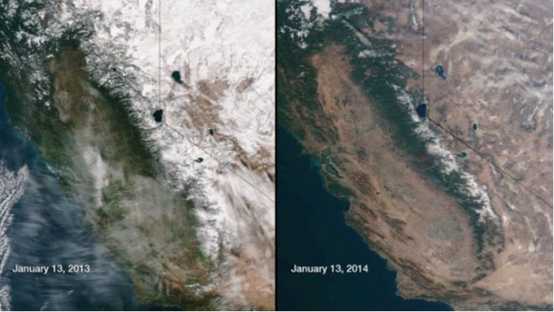
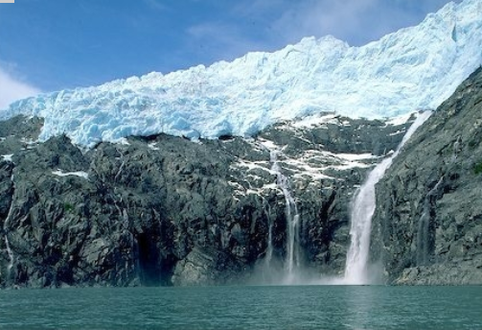
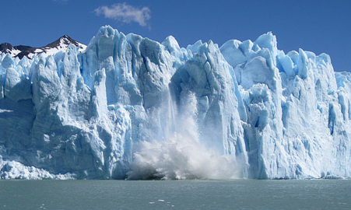
Global Climate Impacts:
Glacier &
Snow Pack Loss
California Snow Pack 2013-2014
Hindu Kush

Slide 10
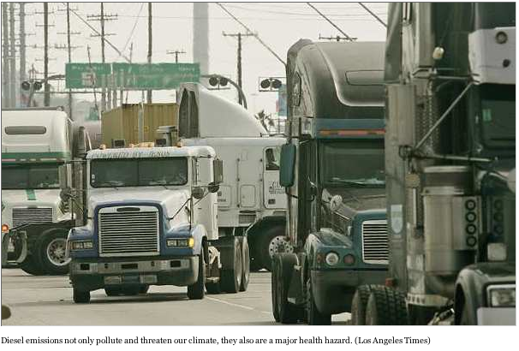
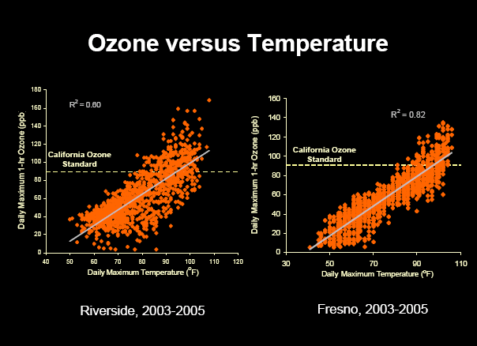
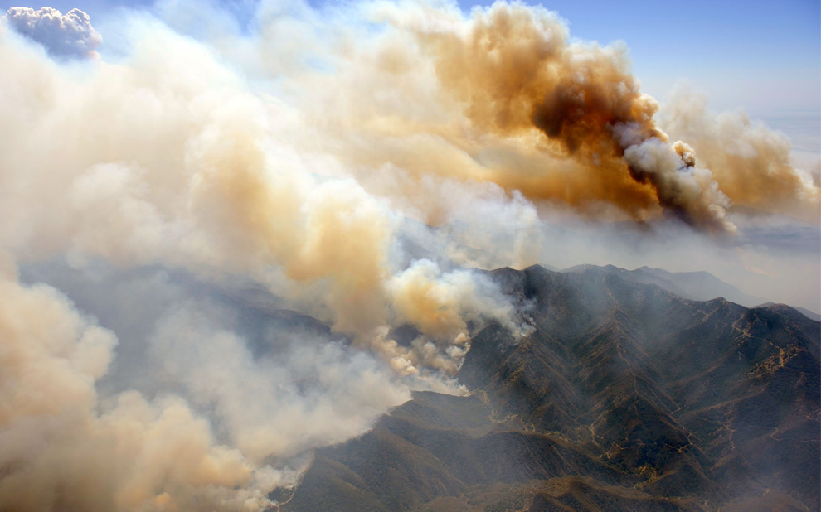
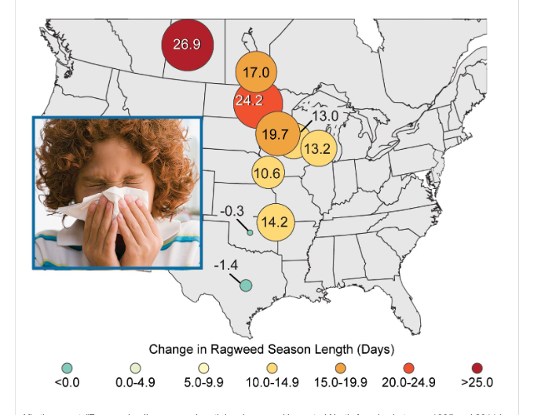
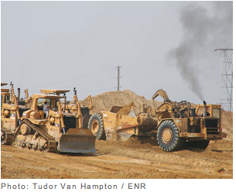
Higher Temperatures Worsen Air Pollution
Intermediate
Factors

Slide 11
Drought and Health
Intermediate
Factors
Water quantity
Water quality
Food insecurity
Wildfire
Dust
Vector-born disease
Infectious disease
Sanitation
Recreational risk
Mental Health

Slide 12
Climate Health Impacts
Extreme weather injuries, drownings, fatalities
Heat-related illnesses and deaths
Air pollution impacts – respiratory, cardiovascular
Allergic disease
Infectious disease
Water and food-borne disease
Vector-borne disease
Food insecurity and malnutrition
Water insecurity
Displacement and migration
Stress and mental health impacts
Notes:
Injuries and drowning,
heat illness, water-,
food-, and vector-borne
illness, displacement,
food/water insecurity,
stress/mental health,
chronic disease
A billion at risk for hunger today: could double by mid-century

Slide 13
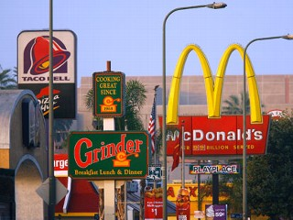
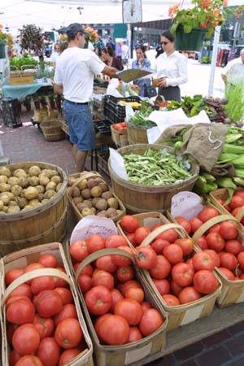
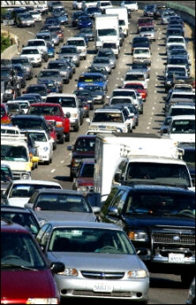
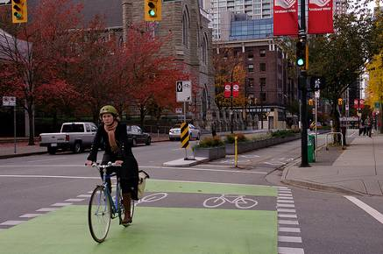
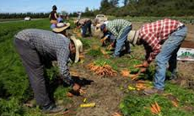
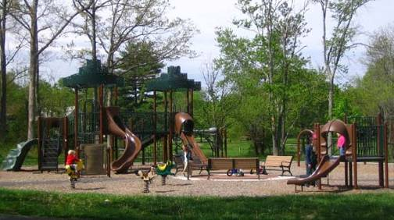
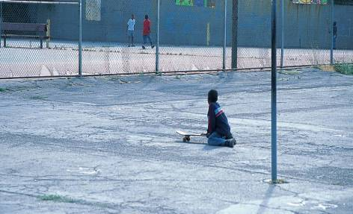
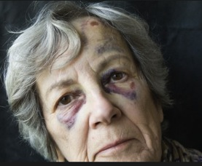
Living Conditions:
Physical, Social, Economic, Services Environments
Notes:
We all have a role to play in creating healthy communities.
Environments in which people live, work, study and play impact health
Decisions made by “non-health” agencies play a major role in shaping environments
Consideration of health allows agencies to make more informed policy and program decisions and to identify win-wins

Slide 14
Social Determinants of Health
Education
Income
Inequality
Race & ethnicity
Gender
Early child experiences
Social support
Employment
Social & cultural environments
Built environment
Housing
Transportation
Green space
Food environment
Stress

Slide 15
"Social injustice is killing people on a grand scale.” WHO Commission on the Social Determinants of Health, 2008

Slide 16
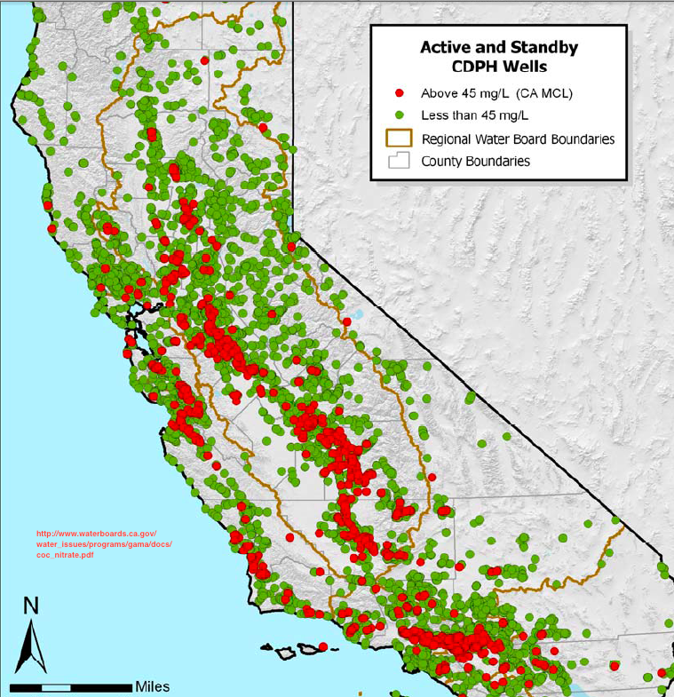
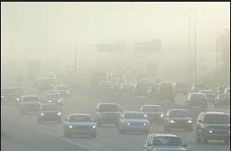
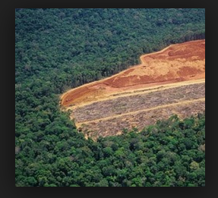
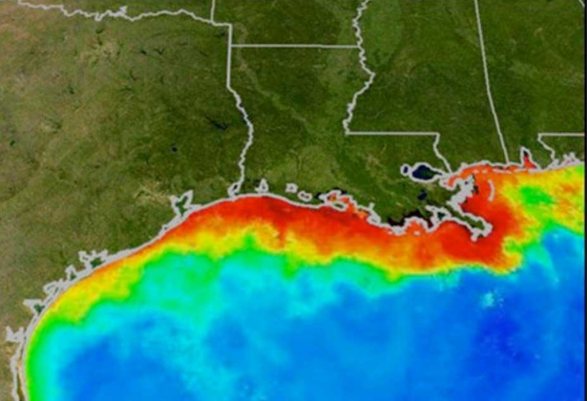
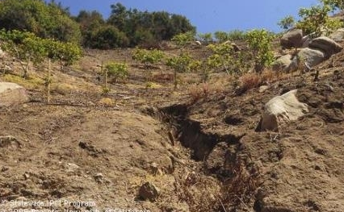

Slide 17
Vulnerability & Resilience
Vulnerability
the degree to which human populations are susceptible to, and unable to cope with, adverse impacts of ecological or climate change due to both environmental and individual factors
Resilience
the capacity of an individual, community, or institution to dynamically and effectively respond to shifting climate impact circumstances while continuing to function and prosper
Characteristics of resilience or vulnerability co-exist at the same time in any community or individual.
Together, the intersection of resources, including social connection, coping mechanisms, exposures, and susceptibility that will determine the extent to which climate change impacts health and well-being.

Slide 18
Health & Health Inequities
Living Conditions
Individual & Community Climate Vulnerability & Resilience
Climate Change Health & Inequities Impacts
Other Environmental Impacts

Slide 19
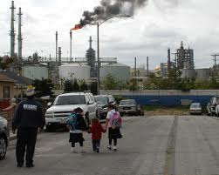
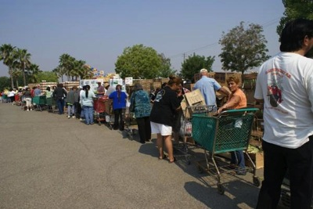
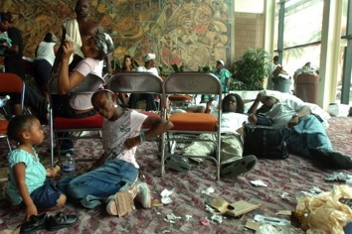
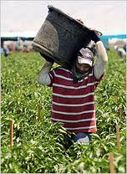
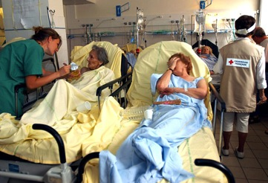
“Climate Gap”
Climate
Health Inequities

Slide 20
Active Transportation Co-Benefits
Reductions
Air pollution
Noise
Infrastructure costs
Community severance
GHG emissions
Increases
Physical activity
Social capital
Reductions
Respiratory disease
Cardiovascular disease
Diabetes
Depression
Osteoporosis
Cancer Stress
Avoidable increases
Bike/ped injuries

Slide 21
ITHIM Preliminary Projections of Health Impacts of Increased Bicycling and Walking: 4 to 19 minutes of daily physical activity, SCAG Region
Active Transportation Co-Benefits
 | Change in disease burden | Change in premature deaths/yr
Cardiovascular Dis.* | 12% | 3,134
Diabetes | 12% | 374
Depression | 3% | <2
Dementia | 6% | 465
Breast cancer | 3% | 60
Colon Cancer | 3% | 75
Road traffic crashes | 22% | 315
* Ischemic heart disease, stroke, hypertensive heart disease
Notes:
CARB estimated air quality benefits in South Coast Air Basin due to air pollution benefits of the 2008 Scoping Plan –, LCFS, RPS, many other benefits:
360 averted premature deaths in 2020;
From all other CARB air pollution measures including 2007 State Implementation Plan (Clean air act): 6800 averted premature deaths in 2020

Slide 22
Co-benefits of Sustainable, Local Food Systems
Reductions
GHG emissions
Pesticide use
Synthetic fertilizer use
Food miles
Antibiotic use
Water pollution
Soil erosion
Biodiversity loss
Meat consumption
Unsustainable H2O consumption
Increases
Access affordable healthy food
Rural community strength
Agricultural land preservation
Reductions
Obesity
Cardiovascular disease
Cancer (breast, prostate, colorectal)
Type II Diabetes
Antibiotic resistance
Pesticide illness

Slide 23
Co-Benefits of Energy Efficiency & Clean Energy
Reductions
Air pollution
Household & outdoor
Mold
Fuel poverty
Improve indoor environment
Better ventilation
Decrease moisture
Improve lighting
Well-being/comfort
Reduce
Asthma
Respiratory disease
CVD
Allergy

Slide 24
Heat Resilience Co-Benefits
Urban greening
Places to be active
Healthy food access
Reduce storm water run-off
Decrease flooding risk
Replenish groundwater
Improve aesthetics
Reduce crime
Reduce heat island effect
Reduce heat illness risk
Decrease energy consumption
Lower energy costs
Reduce air pollution
24
Notes:
Urban greening – especially urban forestry – has many health benefits (review)

Slide 25
Co-Harms
TOD: Displacement
Job Loss
Green Jobs: Occupational Risks
Groundwater Use: Subsidence
LCFS: Food Prices & Insecurity
Market Mechanisms:
Pollution in EJ Communities
Notes:
Developed countries annually provide $13 billion in subsidies and protection to encourage biofuels production, which have diverted 120 million tons of cereals away from human consumption for conversion to fuel. In the United States alone, 119 million out of 416 million tons of grain produced in 2009 went to ethanol distilleries. The grain would have been enough to feed 350 million people for a year! An unpublished World Bank report found that biofuels forced global food prices up by 75 per cent—far more than previously estimated …http://www.un.org/esa/socdev/rwss/docs/2011/chapter4.pdf

Slide 26
Climate Change and Health
Climate change has direct impacts on health
Climate change effects the systems on which human life depends – air, water, food, shelter, security.
Climate change is a threat multiplier
exacerbates existing health challenges
Climate change disproportionately impacts vulnerable populations and disadvantaged communities
exacerbates health inequities
Co-benefits offer many opportunities to simultaneously improve health and address climate change

Slide 27
iCHEAP
integrate
Climate, sustainability,
Health, and
Equity in
All
Policies

